Slide 1
Clustering Capstone Project
Project Title
NETFLIX MOVIES & TV SHOWS CLUSTERING
Ajith R

Slide 2
CONTENT
Introduction
Abstract
Problem Statement
Basic Data Exploration
EDA
Hypothesis Testing
Algorithms
Finding Number of Clusters
Conclusion

Slide 3
Introduction
Netflix is a prominent OTT platform with a wide variety of content to view from a variety of nations and genres, so keep an eye on it.
The purpose is to forecast clusters based on similar content by comparing text-based features, in this example, the description column, which is a brief graphic overview of the contents.

Slide 4
ABSTRACT
The idea was to use text-based variables to anticipate clusters of related content.
The dataset is subjected to exploratory data analysis in order to extract insights from it, but the initial null results are ignored.
After that, our target variable, the description column, must be feature engineered, with NLP operations such as symbol removal, stop words, punctuation, tokenization, and vectorization using TF-IDF done on it.
In addition, after clustering, some hypothesis testing was done.
All that was left was to discover the clusters, fit our models based on the number of clusters.

Slide 5
PROBLEM STATEMENT
This dataset consists of tv shows and movies available on Netflix as of 2019. The dataset is collected from Flixable which is a third-party Netflix search engine.
In 2018, they released an interesting report which shows that the number of TV shows on Netflix has nearly tripled since 2010. The streaming service’s number of movies has decreased by more than 2,000 titles since 2010, while its number of TV shows has nearly tripled. It will be interesting to explore what all other insights can be obtained from the same dataset.
Integrating this dataset with other external datasets such as IMDB ratings, rotten tomatoes can also provide many interesting findings.

Slide 6
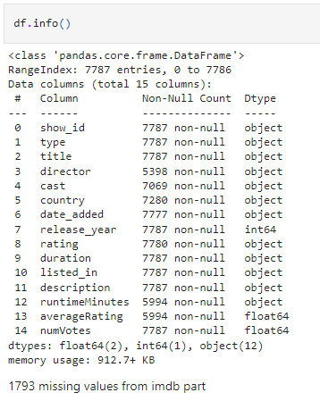
Basic Data Exploration
● The dataset had 7787 observations and 12 features(columns) initially.
● After matching the original dataset with IMDB dataset, we obtained few more columns

Slide 7
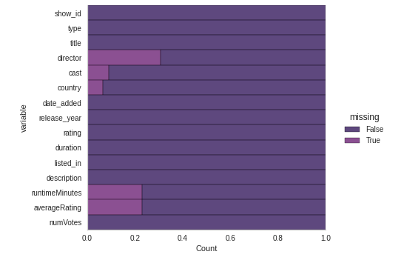
EDA (Checking NaN values)
Director column has the most missing values

Slide 8
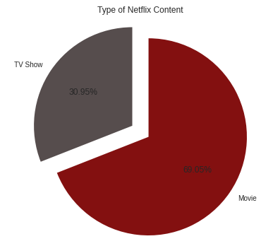
Movie And Tv Show count
About 69% are movies and 31% are tv shows in our dataset
We have 5377 movies and 2410 tv shows in actual numbers

Slide 9
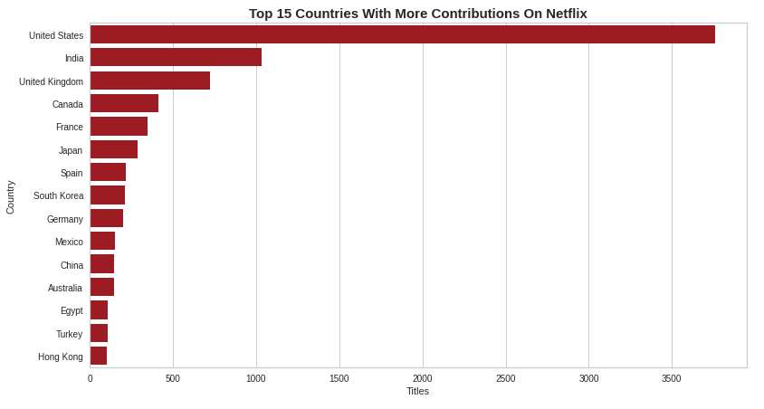
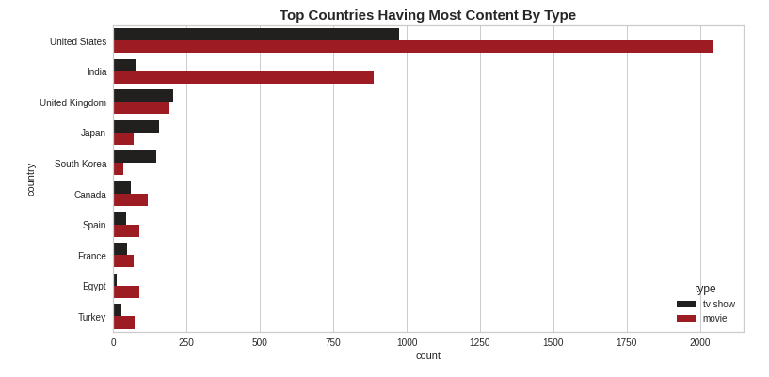
Top countries by content count
The Top 3 countries with most contributions are namely United States with 3760 contents, India with 1033 contents and United Kingdom with 722 contents for netflix
The Top two countries United States and India are interested in contributing more movies than tv shows.
United Kingdom is giving equal weightage for both movies and tv shows
Japan and South Korea is focusing more on tv shows
Rest all other countries in lower bracket are clearly concentrating on movies

Slide 10
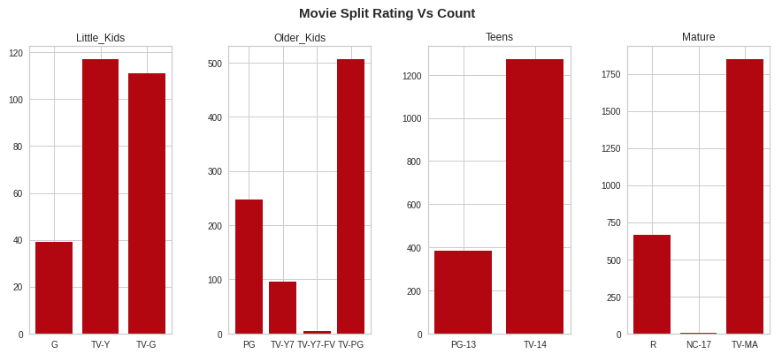
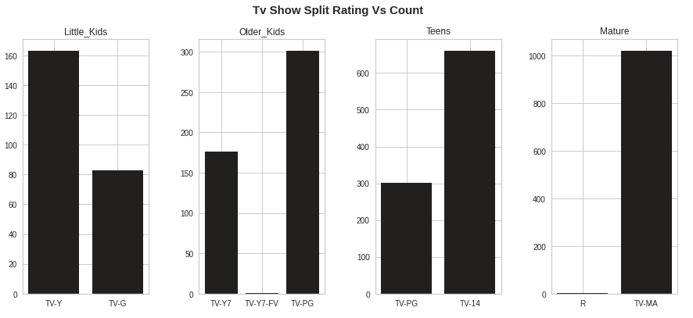
Age Target By Rating and Type of Content

Slide 11
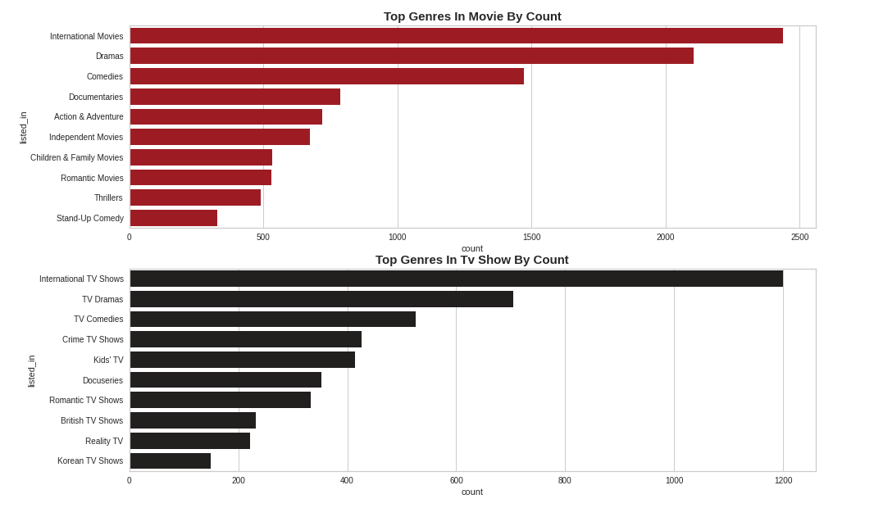
Top Genres by Content Type with Count
The Top 3 Genres for movies is International movies, Dramas and Comedies
The Top 3 Genres for Tv shows os International Tv shows, TV Dramas and TV Comedies

Slide 12
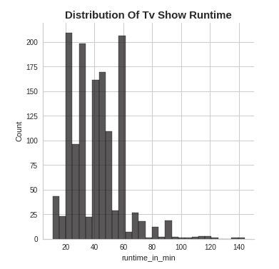
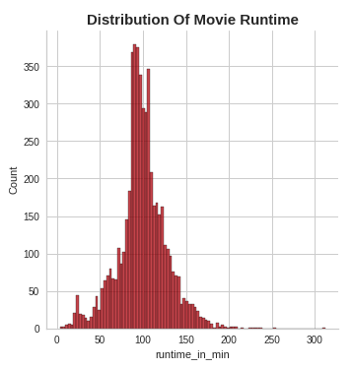
Distribution Of Movie and Tv show(per episode) runtime
25 and 60 minutes per episode have the top counts above 200 where as 35 minutes per episode have the count of 190
Also we can see tv shows with duration 140 mins at max, which might be Documentaries
Top most runtime in movie is 90 minutes with 370 count
Most of the movie runtime is within its mean between 80-120 minutes

Slide 13
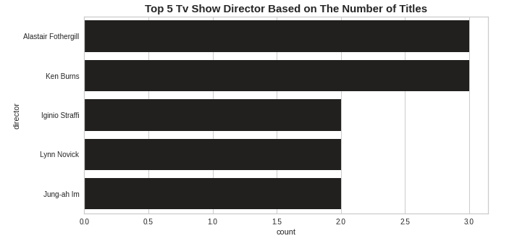
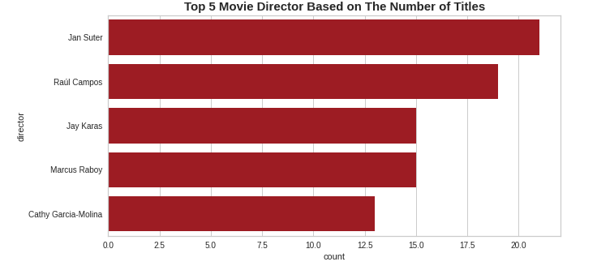
Top 5 Tv Shows and Movie Directors By Number Of Titles
Alastair Fothergill and Ken Burns have the top counts of 3 tv show directions
Maximum Count is 3 Directions in tv show
Jan Suter and Raul Campos have the top counts of 21 and 19 movie directions
Maximum Count is 21 Directions in movie

Slide 14
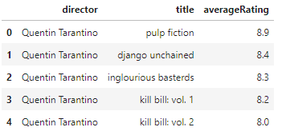
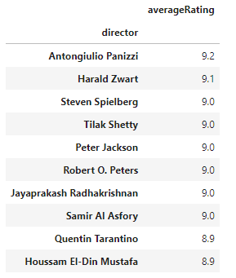
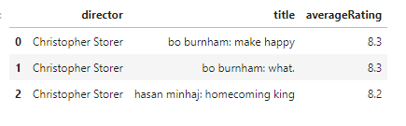
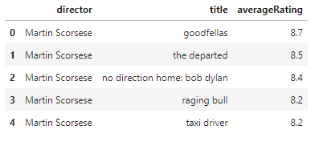

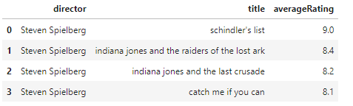
Top Directors in movies by rating

Slide 15
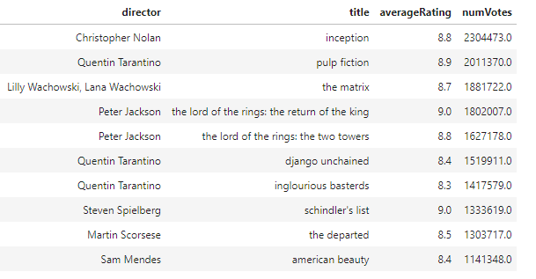
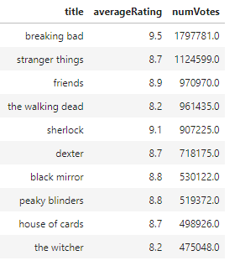
Top Movie and Tv show By Maximum Number Of Votes

Slide 16
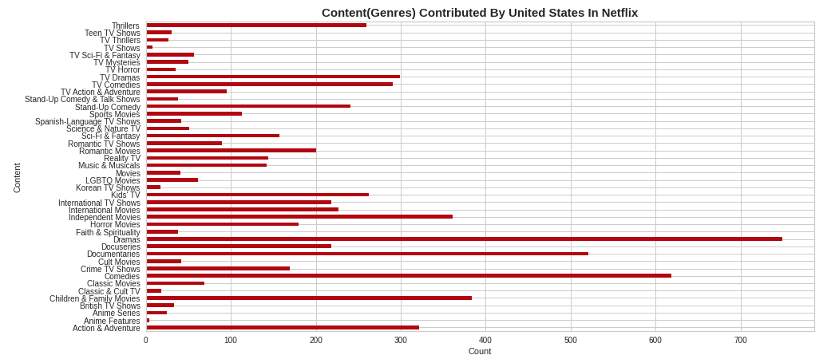
Understanding what type content is available in different countries
United States have contributed in genre Dramas the most
India has contributed in International Movies the most
United Kingdom has contributed more in British Tv Show
Canada have contributed more in Comedies Genre
France has also contributed in International Movies the most
Japan has contributed more in International Tv Shows

Slide 17
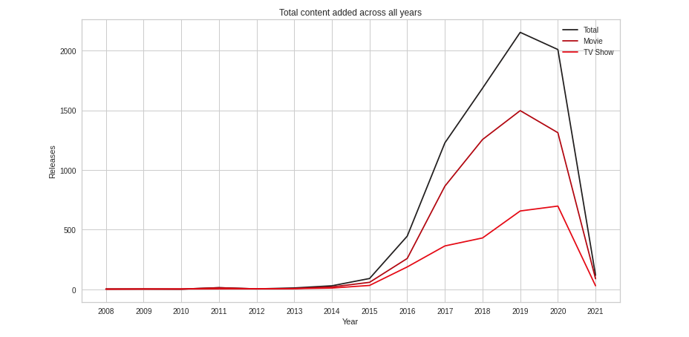
3. Is Netflix has increasingly focusing on TV rather than movies in recent years.
The growth in number of movies from this netflix dataset is much higher than that of TV shows
About 1500 new movies were added in the year 2019
The growth in content started from 2013 and stared falling from the year 2020
From the year 2019 to 2020 movies have dropped with almost 200 content, whereas in tv show it has increased its content a bit

Slide 18
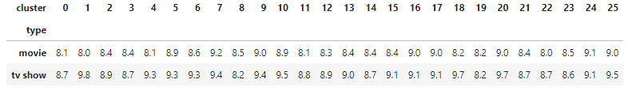
Hypothesis Testing
Firstly this dataset is a sample from netflix contents, so for a moment let's assume this sample data are the only contents available in netflix for users
Let's assume that the above clustered data is the actual recommendation for netflix customers. Ex: If a customer watches a movie from cluster 1, then his next recommended movie or tv show are from the same cluster 1.
Recommendation for a customer is given based on top IMDB rated Movies and Tv Shows in that cluster. Ex: If a customer watched a movie or tv_show form cluster 1, his next recommendation have equal weightage to display him both top IMDB rated movie as well as tv show from cluster 1.
Let's assume that people prefer to watch both movies and tv shows equaly (both movies and tv show have 50 % probability to be watched next), and they are more likely to watch movie or a tv show which has highest IMDB rating.
Null Hypothesis: Tv Show's mean rating is equal to Movie's mean rating.
Alternative Hypothesis: Tv Shows mean rating is greater than Movie's mean rating
Using alpha = 0.05, Since p value is 0.0019 which is lesser than alpha value we reject the null hypothesis. There is sufficient evidence than the Tv Show's mean rating is greater than the Movie's mean rating
From the above hypothesis test and its assumption, it's valid that most of the user's may have been attracted to Tv Shows more than movies because of its rating, people tend to watch highly rated content to explore good content, so that netflix made its Tv show availability three times morer.
After observing streaming rate for Tv Shows, Tv shows are lengthier and way more addictive, Netflix had made its availability three time morer is my theory.

Slide 19
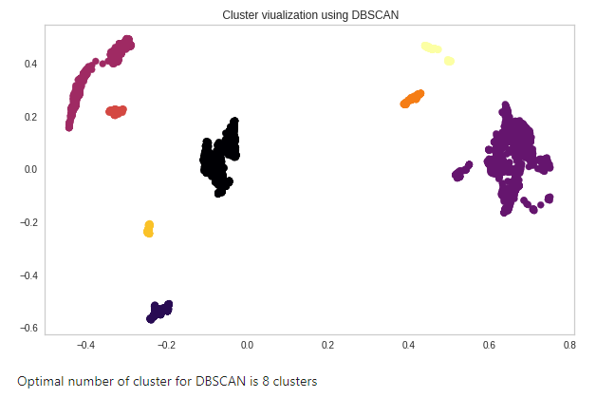
DBSCAN

Slide 20
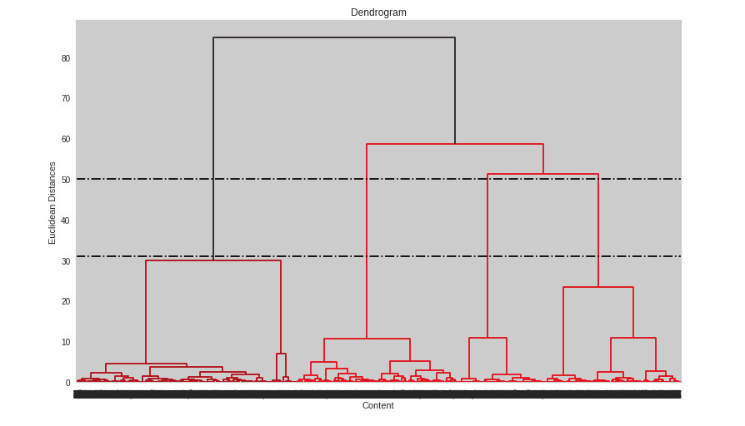
Dendrogram
The highest distance of the vertical lines are between the above 2 black horizontal lines
So the best optimal number of cluster is 4 clusters from the above dendrogram

Slide 21
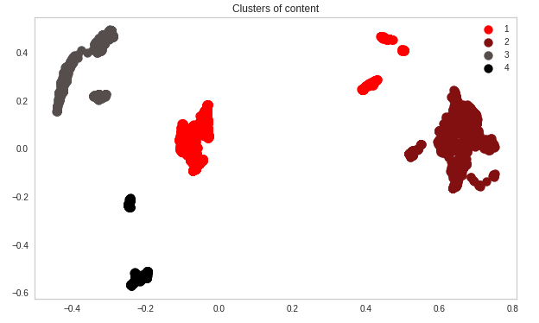
AgglomerativeClustering

Slide 22
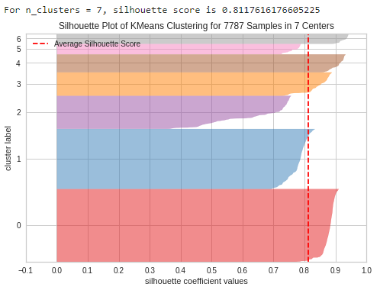
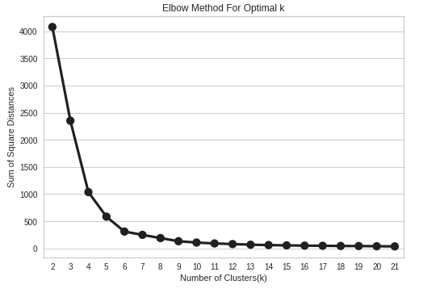
Elbow method and silhouette score for K-means clustering

Slide 23
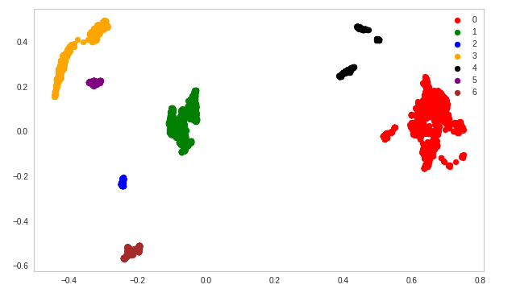
K-Means clustering with optimal clusters

Slide 24
Conclusion
Firstly we did integrate the original dataset for getting IMDB rating and found about 5994 title's rating from imdb dataset
In this dataset there are two types of contents where 30.86% includes TV shows and the remaining 69.14% carries Movies.
In this Dataset 30% of the Directors name were absent.
With the help of imdb rating we found top directors, actors and also titles which had the top ratings.
In clustering part we did cluster by description column for Hypothesis Testing purpose and other text based features separately.
In Clustering for Hypothesis testing we used nlp techniques like stop words, removed punctuations and TF-IDF vectorizer for data prep, further we used PCA for Dimensionality reduction.
In Hypothesis Testing after executing clustering part I picked one in each of the top IMDB rated tv show and movie to compare them and conclude which had the top rating in each clusters, so we found out that in the total of 26 clusters Tv show's imdb rating was high in 23 clusters, further making assumptions in hypothesis testing we declared that people tend to watch tv show more than movies.
In second Clustering part we used UMAP as dimensionality reduction and implemented various models like DBSCAN, hierarchical, Agglomerative clustering, K-means with Elbow , K-means with silhouette and found best number of clusters accordingly
DBSCAN with 8, Hierarchical with 4,K-Means Elbow method with 7 and K-Means Silhouette score with 7 as the best number of clusters.

Slide 25
Thank you

